Slide 1
CUSTOMER RETENTION ANALYSIS

Slide 2
Research Question
Does being part of a loyalty program increase customer retention compared to non-members?
The goal is to determine whether customers enrolled in the loyalty program are significantly more likely to be retained than those who are not.

Slide 3
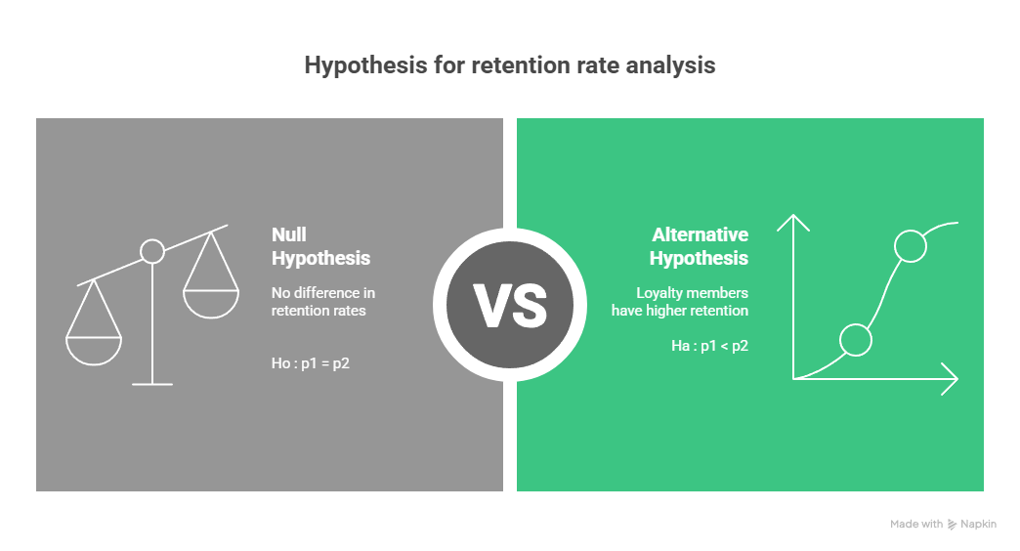
p1 : retention rate of loyalty members
p2 : retention rate of non - members

Slide 4
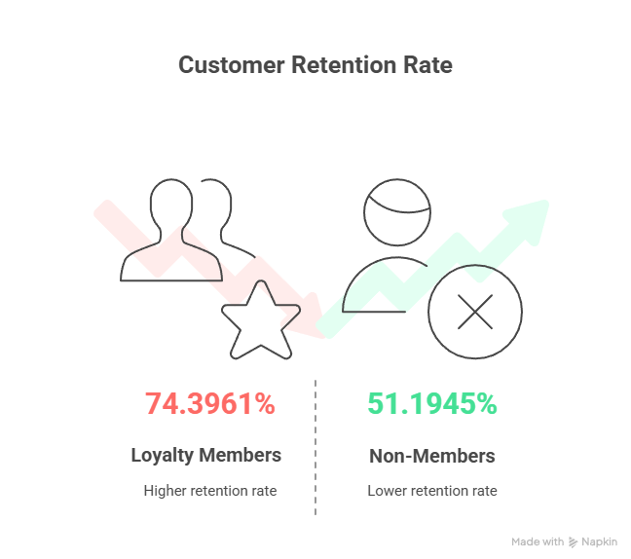
EXPLORATORY DATA ANALYSIS

Slide 5
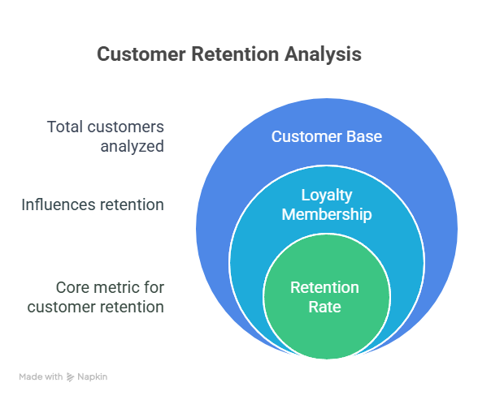

Slide 6
VISUALISATION
Bar Plot: Comparison of retention rates between loyalty and non-loyalty groups
This visuals clearly indicated that loyalty members had higher retention rates than non-members.

Slide 7
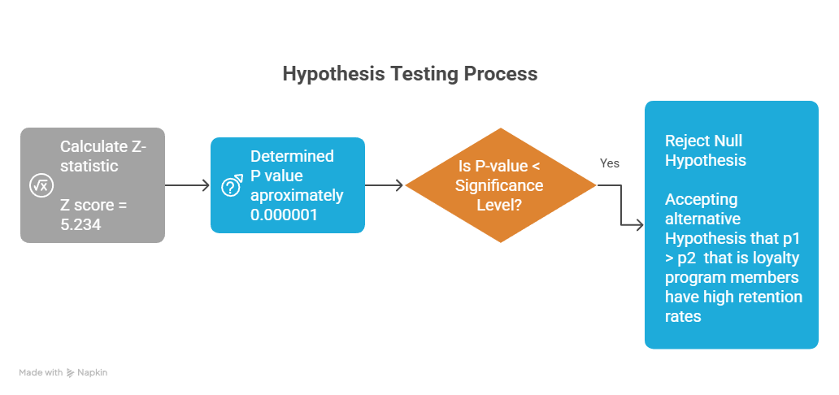

Slide 8
CONCLUSION
There is strong statistical evidence that loyalty program members have a significantly higher customer retention rate compared to non-members.
This confirms that the loyalty program is an effective strategy for improving retention.

Slide 9
LINK OF GOOGLE COLAB : LINK

